Slide 1
HiAI Foundation Use Case and Analysis
DTSE team 10/22/2020

Slide 2
Table of Contents
Background - Purpose and Goal of this report
How to run inference models in Huawei Device
Mobilenet Inference model : Test Cases and Test Results
Demo
Analysis and lesson learned.
Insights

Slide 3
Background
HiAI Foundation is one of key HMS Core solutions that would provide App developers a tool that gives better performance of executing inference models using Huawei Kirin processors in Huawei devices.
The purpose of this report is to demonstrate how HiAI foundation tool is used and how to develop an app based on couple of well-known inference models such as mobilenet and ASR running under Huawei devices.
In this report, we compared xx test cases after running the same model either using an Android ML tool or a HiAI foundation tool and then analyzed the results.
At the end, we provided the benefits and roadmap of using HiAI foundation.

Slide 4
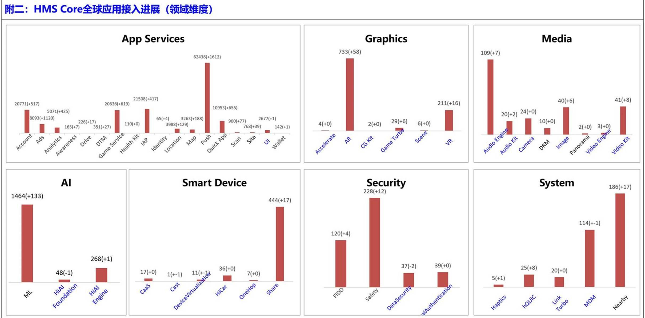
HMS Core AI solutions
Three HMS Core AI solutions

Slide 5
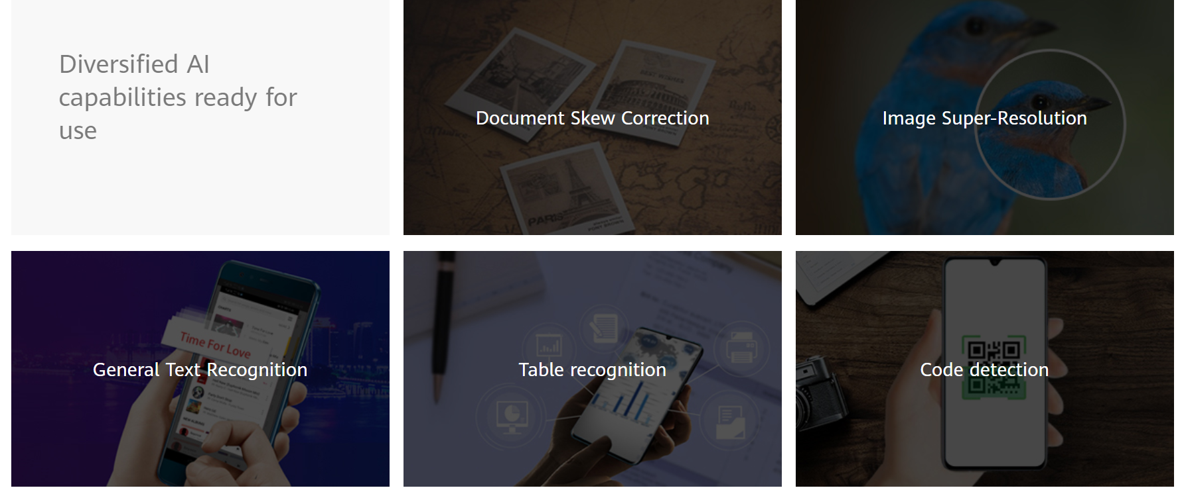
HMS HiAI Architecture and use cases

Slide 6
HMS HiAI Engine Roadmap and Strategy
6 domain use cases
Approach : Open Source Inference model and convert to OM model using HiAI tools.

Slide 7
Android vs Huawei Device for Tensorflow
Trained Tensorflow Model (mobilenet model)
Trained Tensorflow Model (mobilenet model)
Tensorflowlite model convertor (.tflite)
HiAi model convertor (.om)
Android Device
Huawei Device
Android App
Android App
Java API
Java API
C++ API
C++ API
Interpreter
Interpreter
Kernel
Kernel
Android Neural Networks API
HiAi Engine
CPU/GPU/Kirin Chip
CPU/GPU/NPU Chip

Slide 8
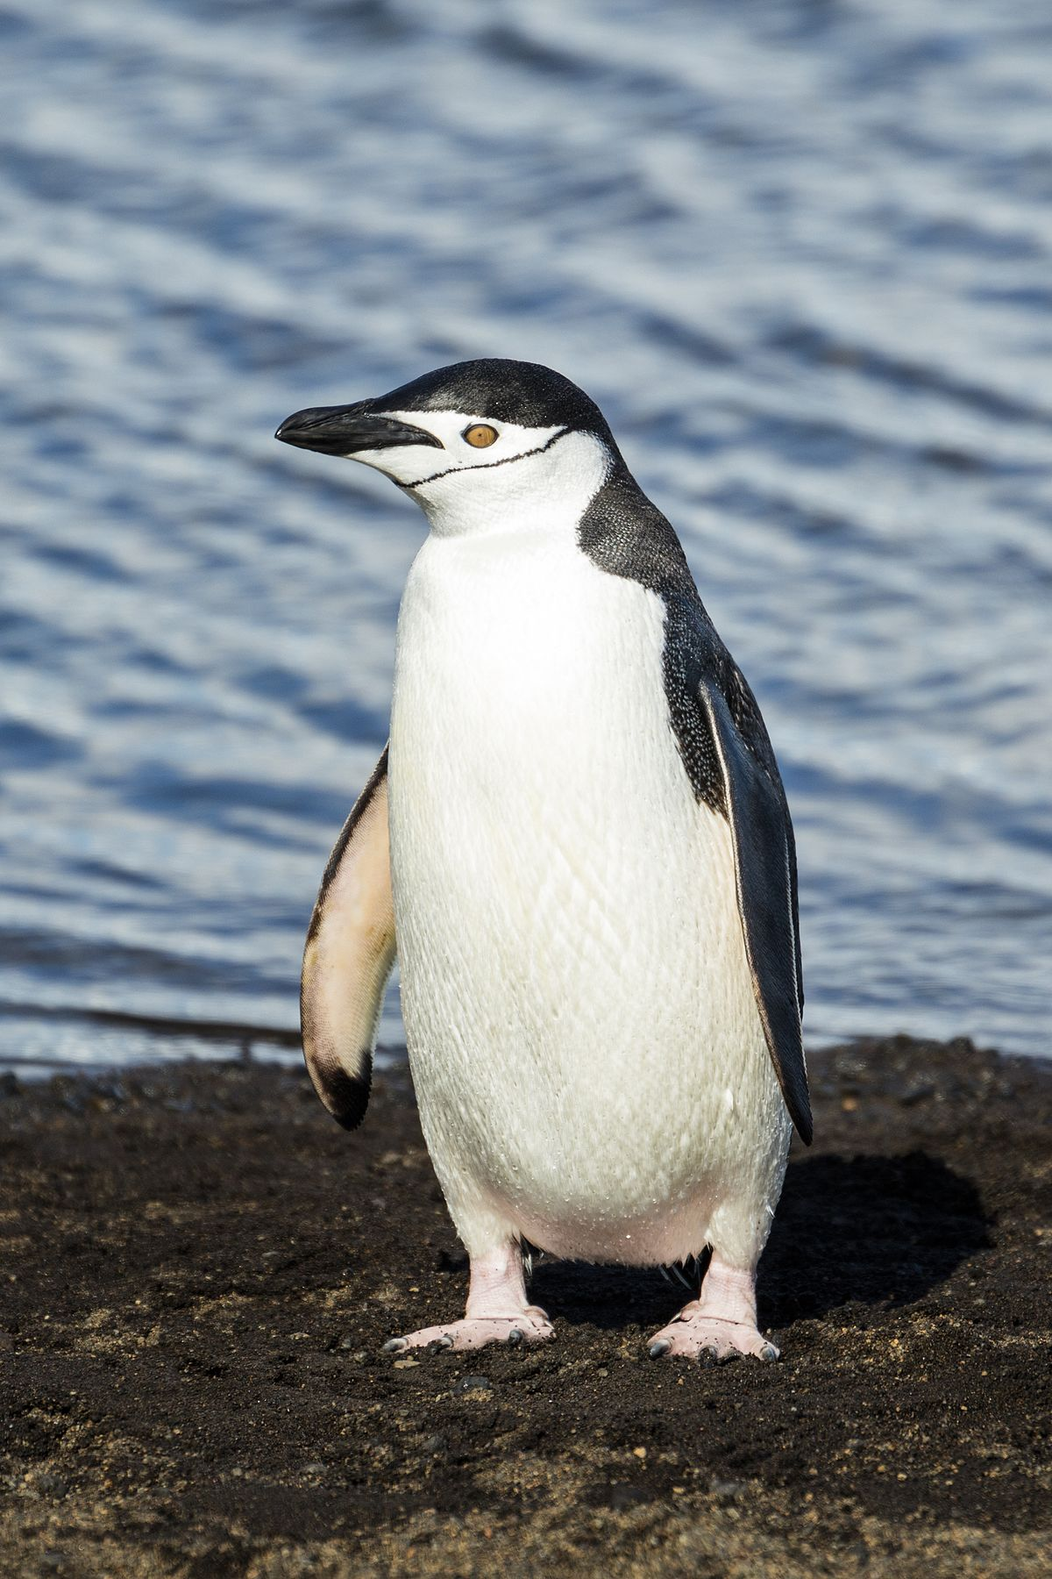
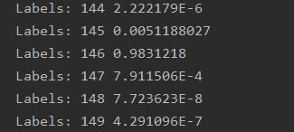
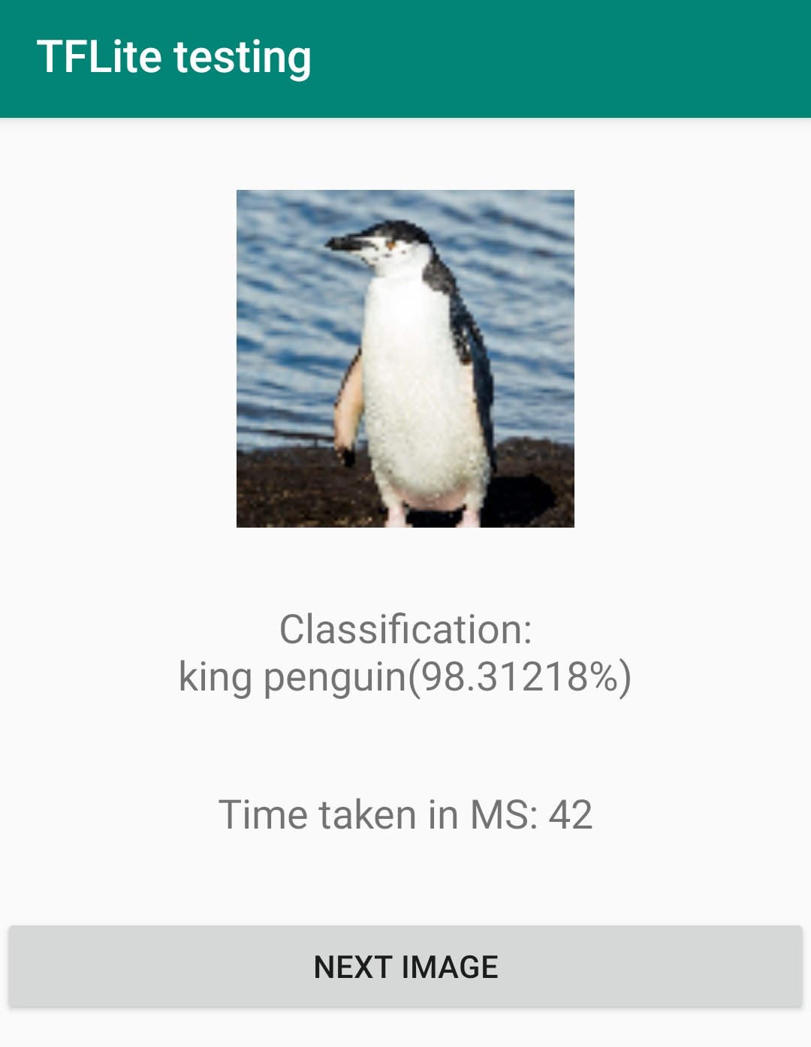
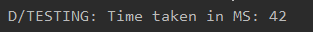
How to run Mobilenet using Android Device and Tflite
Raw data: original image, .jpg or .png, any size
Raw data
Raw output
Processed output
Preprocessing: Select a 224X224 square of pixels around the center. Convert the square image into bitmap. Convert bitmap into bytebuffer in NHWC format
Input to Model: image, 224X224 in size for this specific model, NHWC input format
Converted model: .tflite model. One input at a time, mobilenet supports 1000 image labels
Original model: .pb model (using mobilenet)
Raw Output: A list of 1000 label number to confidence values as text. Performance in time (milliseconds)
Processed output: Highest confidence value with its corresponding label name in text. Performance in time (milliseconds).
8
FUTUREWEI INTERNAL

Slide 9
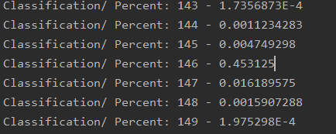
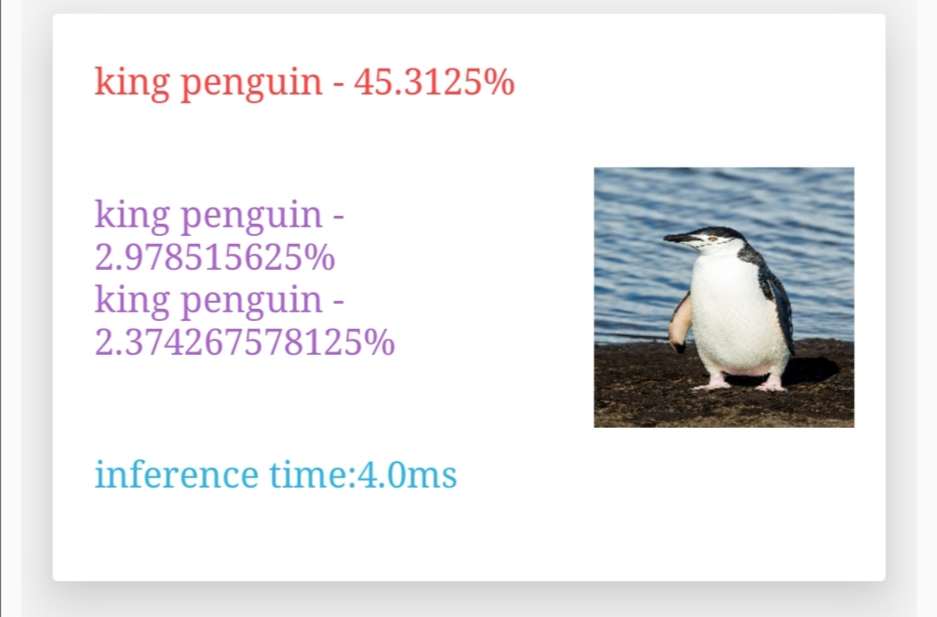
How to run Mobilenet using Huawei Device and HiAI Foundation
Raw data: original image, .jpg or .png, any size
Raw data
Raw output
Processed output
Preprocessing: Select a 224X224 square of pixels around the center. Convert the square image into bitmap. Convert bitmap into bytebuffer in NCHW format
Input to Model: image, 224X224 in size for this specific model, NCHW input format,
Converted model: .om model. One input at a time, mobilenet supports 1000 image labels
Original model: .pb model (using mobilenet)
Performance Comparison between OM vs Tflite
42 ms(previous slide) vs 4 ms
Raw output: A list of 1000 label number to confidence values as text. Performance in time (milliseconds)
Processed output: Highest confidence value with its corresponding label name in text. Performance in time (milliseconds).

Slide 10
Huawei NN Operator VS Tensorflow NN Operator
Huawei Supported NN Operators | Tensorflow Supported NN Operators | Tensorflowlite Supported NN Operators
24 | 121 | <116* (tflite conversion merges some of the NN operators, 5 are often removed)
Please refer to excel sheet.
Huawei Supported NN Operators
tf.nn.atrous_conv2d | tf.nn.conv2d_transpose | tf.nn.l2_normalize | tf.nn.relu6
tf.nn.avg_pool | tf.nn.fractional_avg_pool | tf.nn.leaky_relu | tf.nn.selu
tf.nn.bias_add | tf.nn.fractional_max_pool | tf.nn.log_softmax | tf.nn.softmax
tf.nn.bidirectional_dynamic_rnn | tf.nn.fused_batch_norm | tf.nn.lrn | tf.nn.softplus
tf.nn.conv1d | tf.nn.depthwise_conv2d | tf.nn.max_pool | tf.nn.softsign
tf.nn.conv2d | tf.nn.elu | tf.nn.relu | tf.nn.static_bidirectional_rnn
Unsupported Operators in Test Cases
tf.nn.softmax_cross_entropy_with_logits | tf.contrib.deprecated.scalar_summary | tf.contrib.deprecated.merge_summary | tf.signal.mfccs_from_log_mel_spectrograms | audioSpectrogram
BlockLSTM | TensorArrayV3 | TensorArrayScatterV3 | Enter | LoopCond
TensorArrayReadV3 | TensorArrayWriteV3 | NextIteration | Exit | TensorArraySizeV3
FusedBatchNormV3 | CTCGreedyDecoder | TensorArrayGatherV3

Slide 11
Unsupported ASR Operators
Using Tensorflow Simple Speech Recognition.
https://github.com/nicomon24/tensorflow-simple-speech-recognition
Using DeepSpeech 0.6.0.
https://github.com/mozilla/DeepSpeech/releases/download/v0.2.0/deepspeech-0.2.0-models.tar.gz
tf.nn.softmax_cross_entropy_with_logits | tf.contrib.deprecated.scalar_summary | tf.contrib.deprecated.merge_summary
BlockLSTM | tf.signal.mfccs_from_log_mel_spectrograms | audioSpectrogram

Slide 12
Unsupported OCR Operators
Using SimpleHTR.
https://github.com/githubharald/SimpleHTR
Using Attention OCR
https://github.com/da03/Attention-OCR
TensorArrayV3 | TensorArrayScatterV3 | Enter | LoopCond
TensorArrayWriteV3 | NextIteration | Exit | TensorArraySizeV3
CTCGreedyDecoder | TensorArrayGatherV3 | TensorArrayReadV3
FusedBatchNormV3

Slide 13
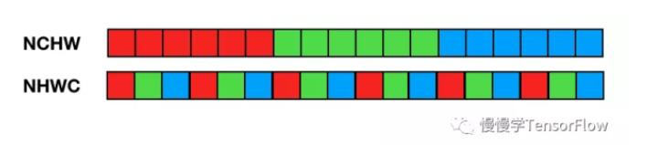
Difference of NCHW and NHWC
Two different data formats, particularly that of images
In NCHW, C is arranged in the outer layer, and the pixels in each channel are close together
In the NHWC format, C is arranged in the innermost layer, and pixels corresponding to the spatial positions of multiple channels are close together
Tensorflow defaults to NHWC, HiAi foundation defaults to NCHW

Slide 14
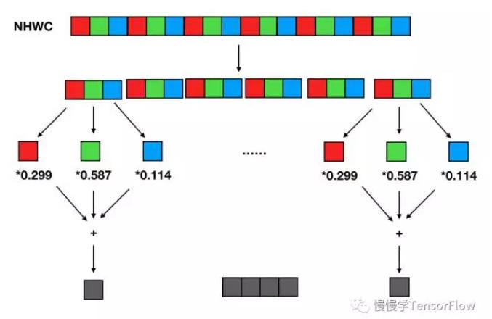
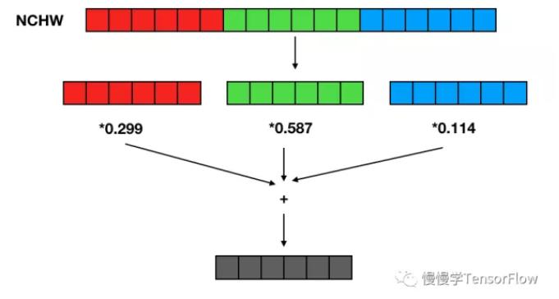
Difference of NCHW and NHWC Cont
NCHW is faster than NHWC on GPU acceleration (with some exceptions)
NHWC is faster than NCHW on CPU
https://www.programmersought.com/article/77463626294/#:~:text=Because%20early%20development%20is%20based,faster%20(with%20some%20exceptions).

Slide 15
Results Table
Using Mobilenet_v2
 | Test 1.a | Test 1.b | Test 2 | Test 3 | Test 4 | Test 5
Client Code | Java (Using Native Android) | Java (Using Native Android) | Java using NNAPI | Java(HiAI DDK) | Java(HiAI DDK) | Java(HiAI DDK)
ML platform | Tflite | Tflite | Tflite | HiAI Foundation | HiAI Foundation | HiAI Foundation
model | mobilenet_v2_1.0_224.tflite | mobilenet_v2_1.0_224.tflite | mobilenet_v2_1.0_224.tflite | OM(converted from mobilenet_v1_1.0_224_frozen.pb) | OM(converted from mobilenet_v2_1.0_224_frozen.pb) | OM(converted from mobilenet_v2_1.0_224_frozen.pb)
model size | 13651KB | 13651KB | 13651KB
Input data | Penguin.jpg ( 1 image) | 104 different images | Penguin.jpg (1 Image) | Penguin.jpg (1 Image) | 200 images, all kingpenguin | 104 images, all different
Output | Classified as king penguin | N/A | Classified as king penguin | Classified as king penguin
Device | Honor V30 | Honor V30 | Honor V30 | Honor V30 | Honor V30
CPU Performance | 40-50 ms | 59 ms (over 104 images) | N/A | NA
GPU Performance | 22-26 ms | 22 ms (over 104 images) | N/A | NA
NPU(kirin 990) sync | N/A | N/A | 60-70ms** | 9-452ms*** | Average Speed: 5.76 ms | Average Speed: 3.3846154ms
NPU(kirin 990) Async | N/A | N/A | N/A | 4-393ms
Confidence | 78.14% |  | 78.14% | 75.20%
Calculated Accuracy |  |  |  |  |  | 72.59615385%

Slide 16
Analysis
Correctness over 104 different images | Mobilenet_v2 correct | Mobilenet_v1 correct
Correct %: | 72.59615385 | 65.86538462
Over the course of the tests we have obtained times for CPU, GPU, and NPU
With mobilenet_v1 on a phone, using Tflite, CPU is around 40-50ms
Generally, GPU is 20-30ms faster at 22-26 ms
Testing on Kirin NPU, the average time is 3-5 ms, 5 times faster
Top 1 Accuracy for each model from benchmark:
Mobilenet_v2: 71.8%
Mobilenet_v1: 71.0%
The HiAi version are close to expected performance. Deviation can be due to sample size and calculation error.
Confidential no discrepancy between Tflite vs OM : why OM is lower?
https://arxiv.org/pdf/1810.01109.pdf

Slide 17
ASR and OCR
What steps needs to be taken to make ASR and OCR to work
Why did not work? ( Not supported Operators, unsupported input types)
Analysis

Slide 18
HiAI Limitation and Roadmap
Not support Pytorch – Roadmap
NN operator support – Roadmap

Slide 19
What help we need from managements to support CPs
Operator supports
Other use case support like ASR

Slide 21
How to use HiAI Foundation (
We converted a tensorflow model into HiAi enabled model through a tool provided by the HiAI package
We imported the model into the code as well a list of labels as you would do to a normal tensorflow model
As the model we were using was one to classify images, we provided the application images.
The images were preprocessed in a NCHW manner. HiAi converted models are all in such a fashion. Preprocessing is like how you would normally handle an image
The model, image, and labels were sent to the engine and was used to generate a list of confidence scores correlated to a label number
The highest confidence score is taken to be the result

Slide 22
How does this help CPs?
Enables CPs to leverage the effectiveness of NPU processing with Huawei devices, freeing resources from CPU and GPU
Faster processing time results in a more responsive program and UI

Slide 23
Comparison
HiAi Example: What the code does
Diagram
What have we learned
Requires NCHW format, needs the image to be conformed
Not obvious in the

